Slide 1
Community Design Indicators
Oregon EPHT
Dan Rubado, Epidemiologist
Environmental Public Health Tracking Program
Office of Environmental Public Health
Oregon Health Authority

Slide 2
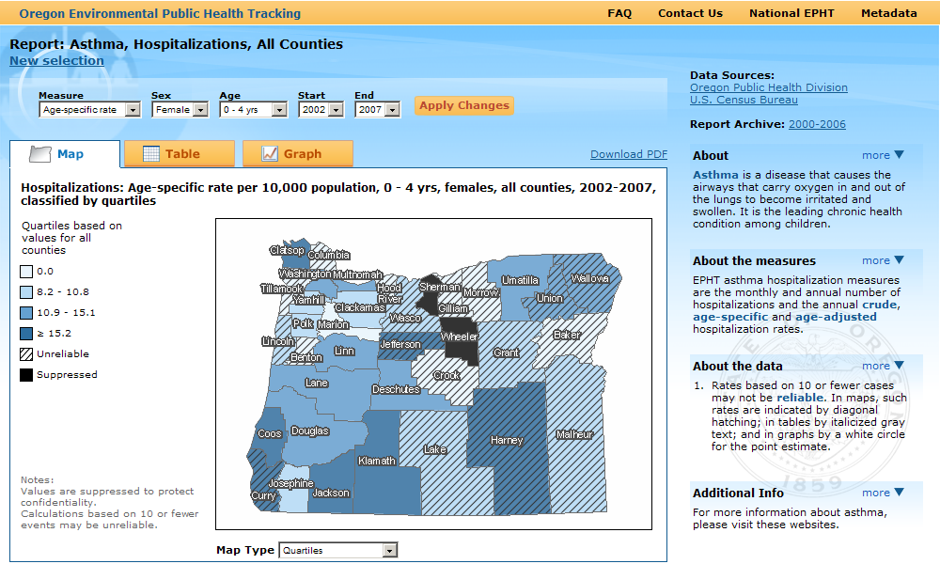
Oregon EPHT Data Portal
Notes:
Website: epht.oregon.gov

Slide 3
Project Objectives
surveillance indicators
to assess the quality of Oregon’s community design
Notes:
Develop useful, consistent, scientifically valid surveillance measures of urban built environments in Oregon
Measures connected to behavior or health outcomes
Track measures over time in the urban areas of Oregon
Make data available to local health departments, planners, non-profits, and the public
Quick, reliable information for community assessment, planning, health impact assessment, and equity analysis

Slide 4
Indicators to Track
Affordable housing
Housing cost burden
Food environment
Grocery, produce, WIC, convenience, fast food, restaurants
Recreation facilities
Parks, schools, bikeways, indoor facilities
Walkability
Street connectivity, walking destinations, density
Public safety
Traffic injuries
Substance use environment
Alcohol and tobacco retailers
Transportation
Public transit, active transportation

Slide 5
Food Availability Measures
Measure | Description | Data Sources | Display | Definitions
Produce market density | # of farmer and produce markets per sq. mile | Employment Department, Farmers’ Market Assn, WIC | raster and choropleth density maps | fruit and vegetable markets, Oregon Farmers' Market Association listed markets
Grocery store density | # of large grocery stores per sq. mile | Employment Department |  | super market or grocery store with >9 employees, warehouse club
Small grocery store density | # of small and specialty groceries per sq. mile | Employment Department |  | grocery store with 5-9 employees or specialty food store
Healthy food density | # of produce, large and small groceries per sq. mile | Employment Department, Farmers’ Market Assn, WIC |  | combination of produce, grocery and small grocery measures

Slide 6
Food Availability Measures
Measure | Description | Data Sources | Display | Definitions
Convenience store density | # of convenience stores per sq. mile | Employment Department | raster and choropleth density maps | convenience stores, gas station stores, grocery stores with <=4 employees
Fast food restaurant density | # of fast food restaurants per square mile | Employment Department |  | large chain restaurants selling inexpensive, calorie dense, high fat, high sugar, high salt, or processed foods
Unhealthy food retailer density | # of convenience stores and fast food restaurants per sq. mile | Employment Department |  | combination of convenience store and fast food restaurant measures
Restaurant density | # of total restaurants per sq. mile | Employment Department |  | all restaurants and prepared food vendors
Retail food environment index | Ratio of # of groceries and produce markets to fast food and convenience stores | Employment Department, Farmers’ Market Association, WIC |  | combination of healthy and unhealthy food retailers

Slide 7
Food Density Calculations
block group boundary
Inverse distance weighted average
food retailer
d1
d2
n = 2
n ≈ 4
n = 6
Block group score = average of grid cells
1 mile
N

Slide 8
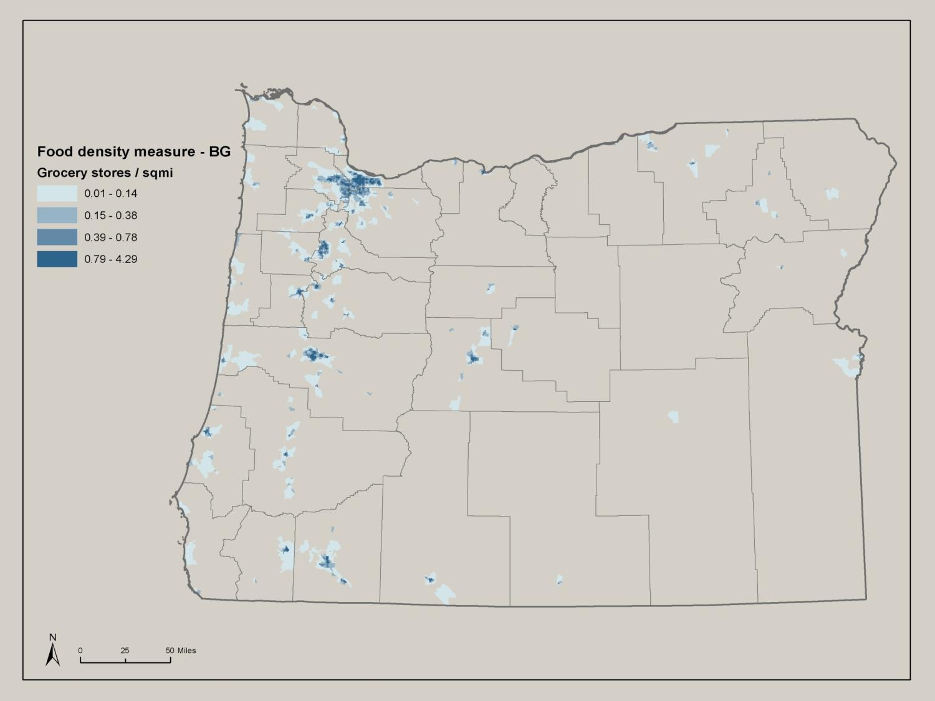

Slide 9
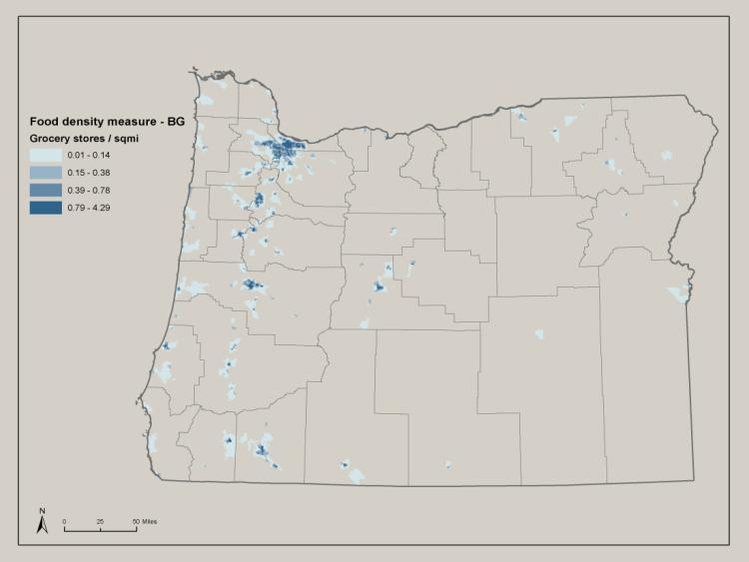
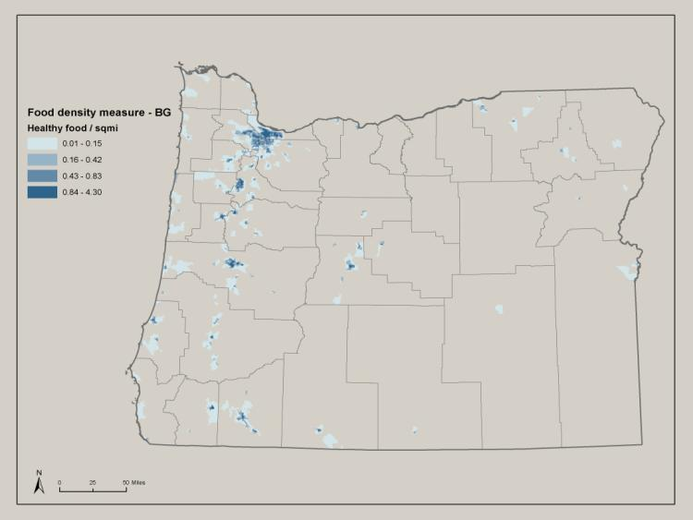
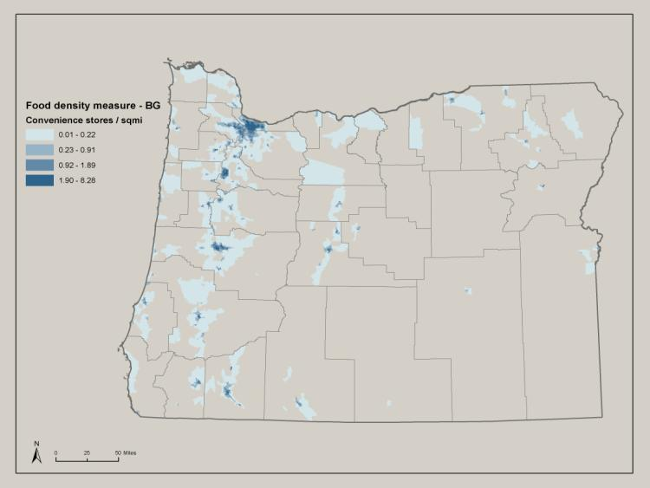
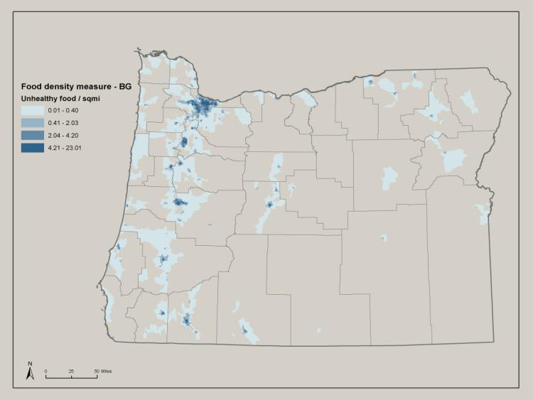

Slide 10
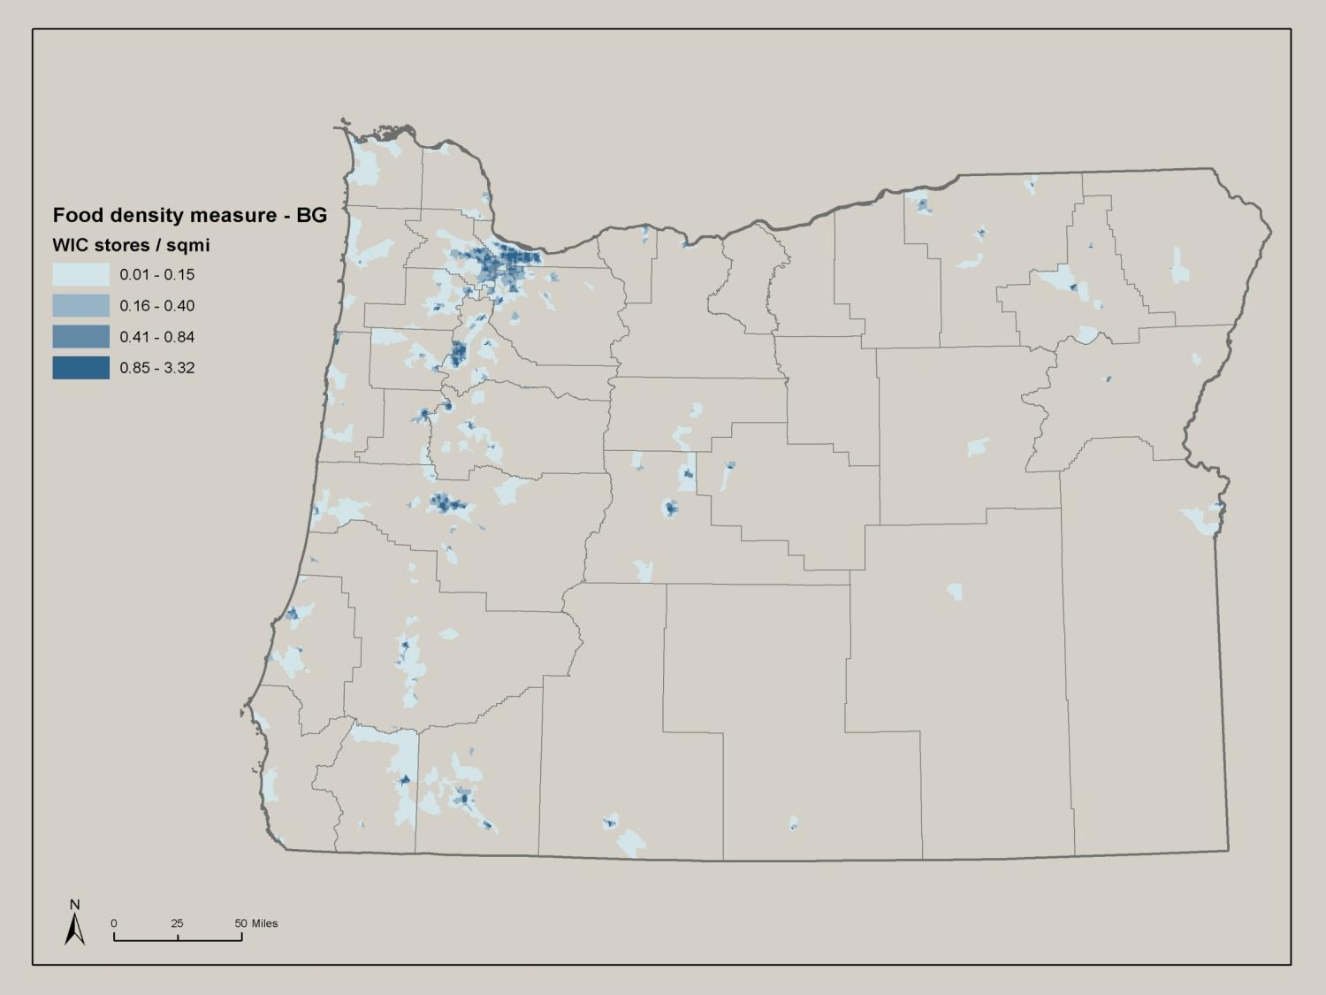

Slide 12
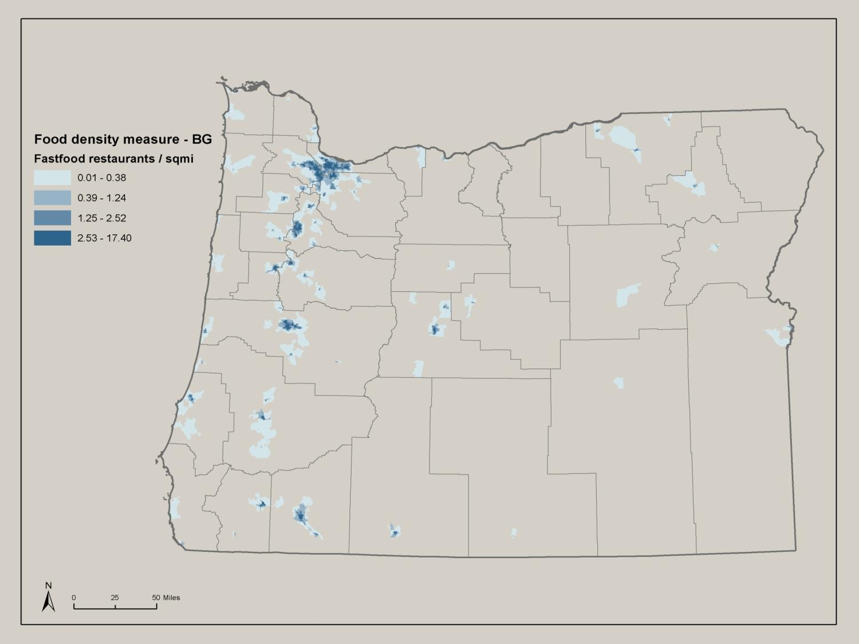

Slide 13
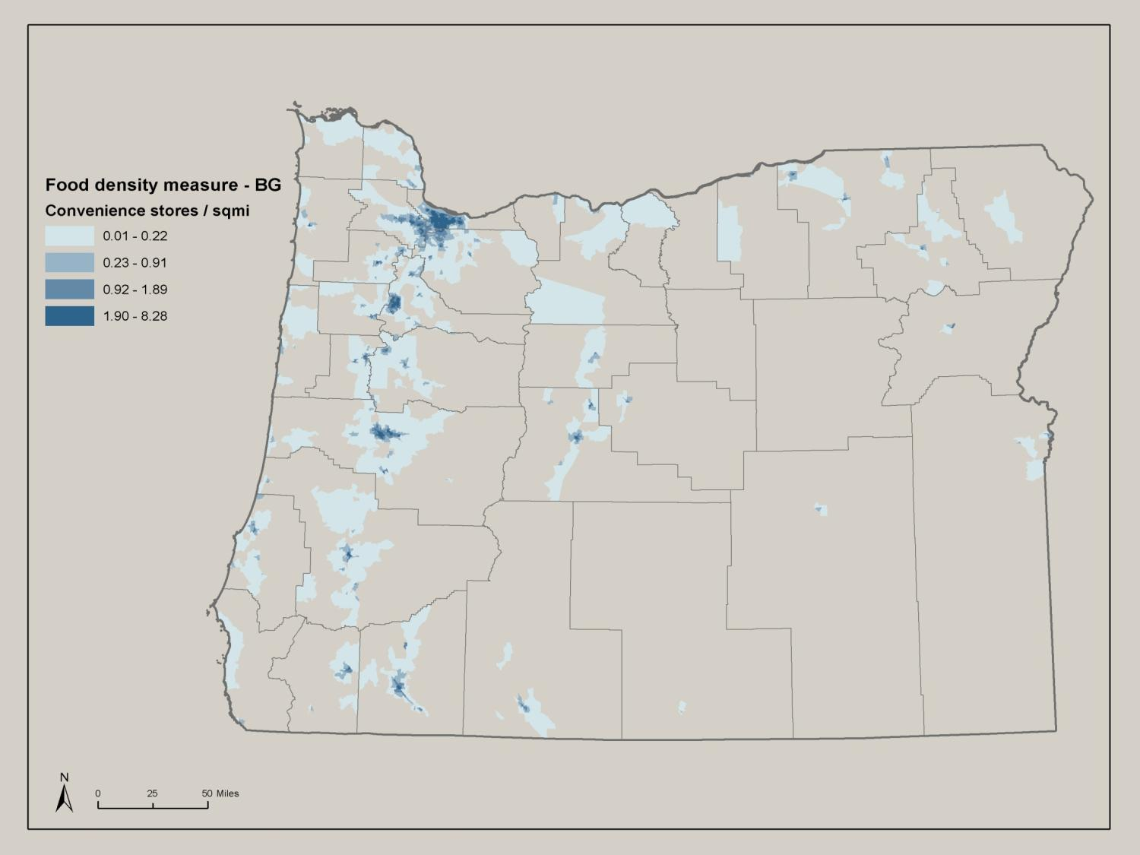

Slide 14
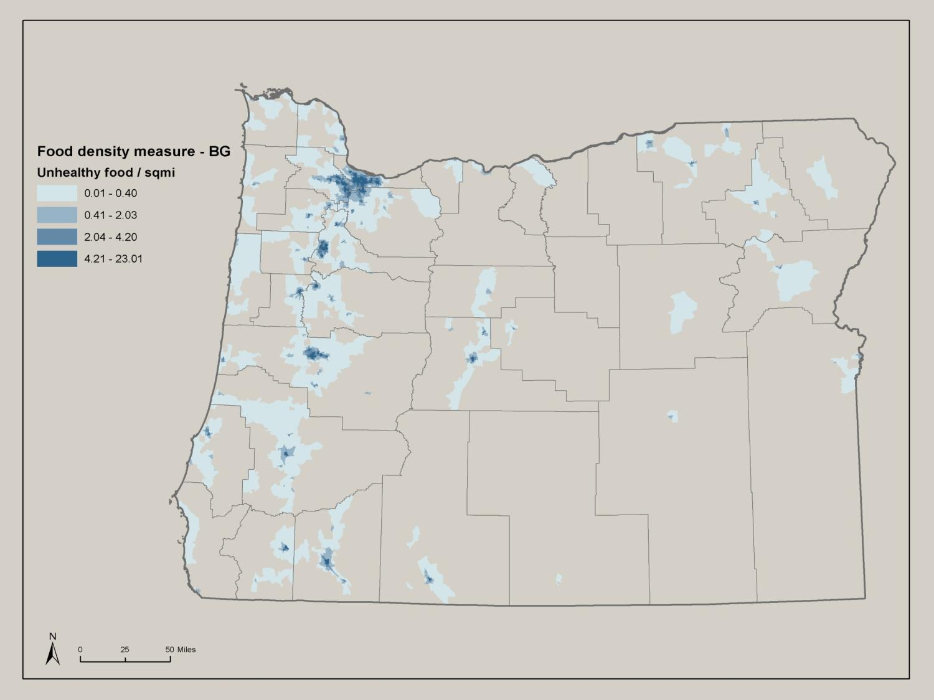

Slide 15
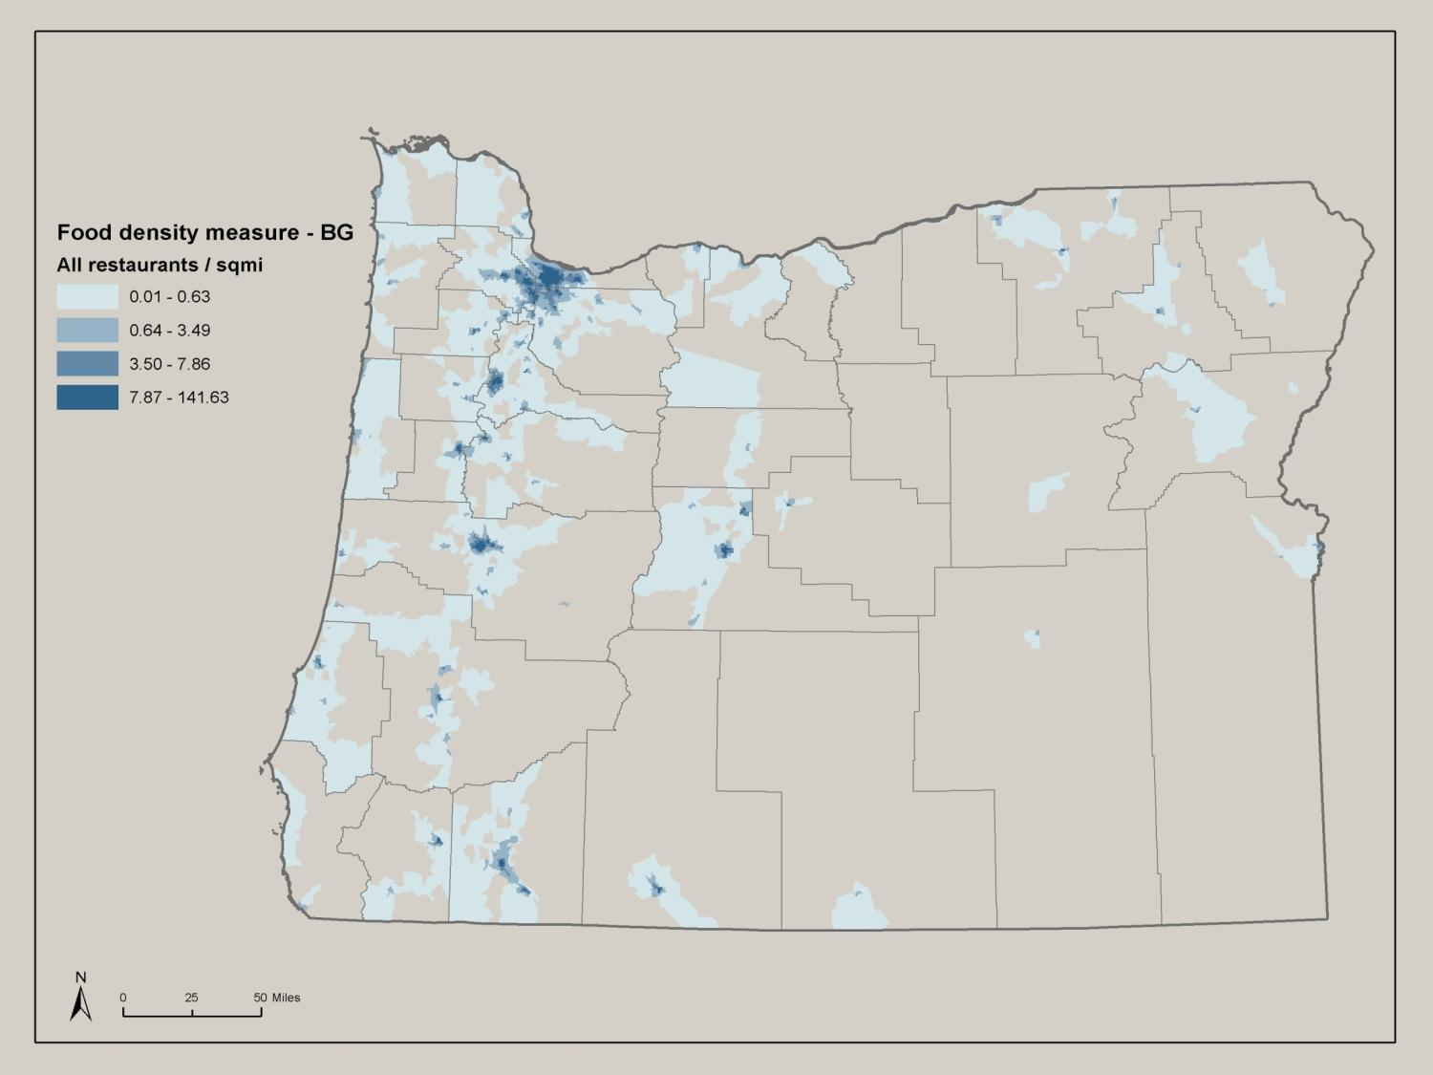

Slide 16
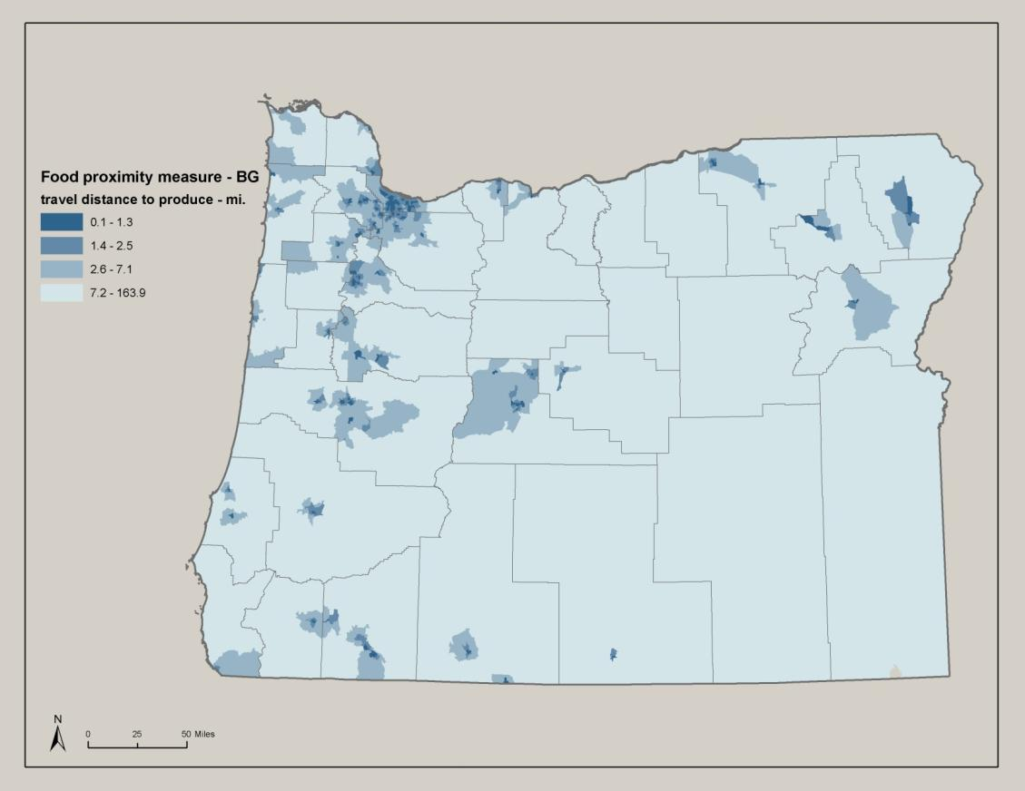
Food Proximity Measures

Slide 17
Active Transportation Measures
Measure | Description | Data Sources | Display | Definitions
Bicycling | % of commuters biking to work | ACS 5-year estimates | Choropleth maps; County and Census tract geography | Commuters are employed workers, 16+ years old, who travel to work (excludes working from home)
Walking | % of commuters walking to work
Public transit | % of commuters taking public transit to work
Active transportation | % of commuters biking, walking or taking public transit to work

Slide 18
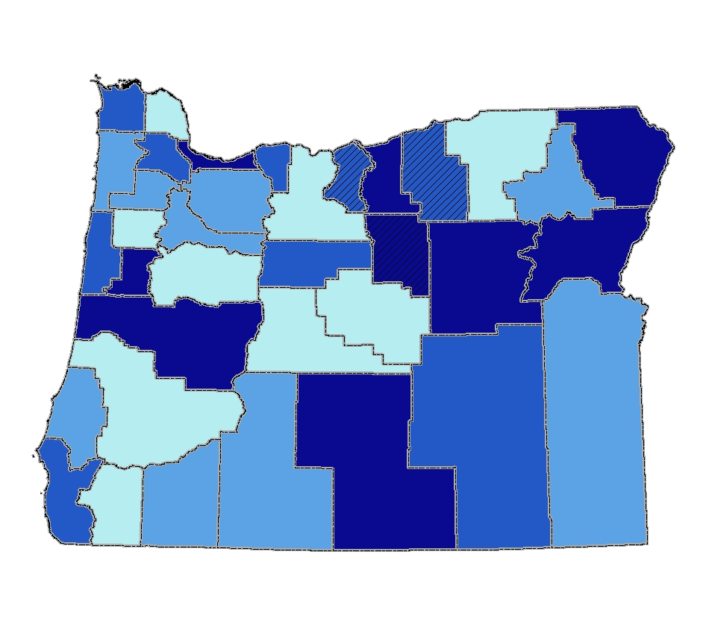
Percent of commuters using active modes of transportation (walk, bike, transit)

Slide 19
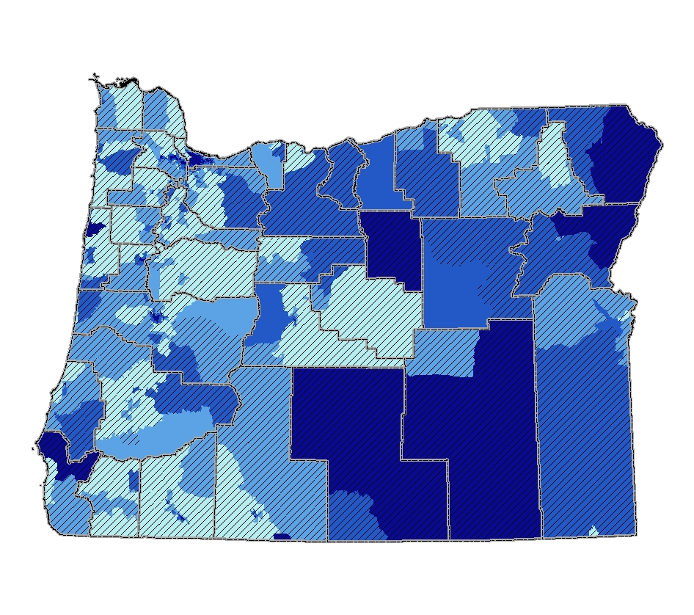
Percent of commuters using active modes of transportation (walk, bike, transit)

Slide 20
Walkability Measures
Measure | Description | Data Sources | Display | Definitions
Intersection density | # of intersections per square mile | ACS streets data | Choropleth | # of street network intersections per square mile, minus highways and
Walking destinations | # of total walking destinations accessible within a X mile network distance | Oregon Dept of Employment | Choropleth + point density | ?

Slide 21
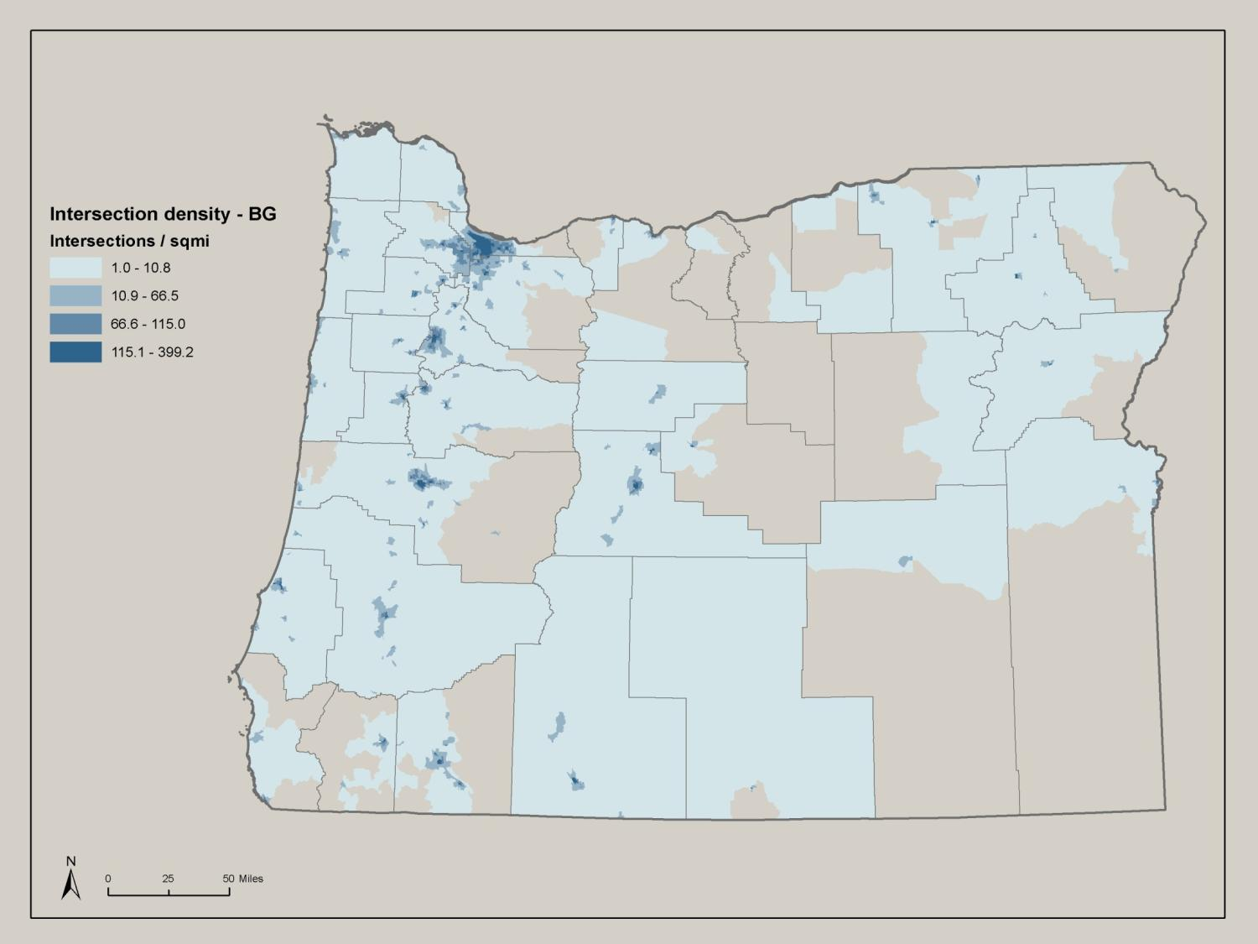

Slide 22
Housing Affordability Measures
Measure | Description | Data Sources | Display | Definitions
Owner cost burden | % of owner –occupied households spending >30% of household income on housing costs | ACS 5-year estimates | Choropleth maps County and census tract geography | Owner housing costs = mortgage + utilities
Renter cost burden | % of renter–occupied households spending >30% of household income on housing costs |  |  | Renter housing costs = rent + utilities

Slide 23
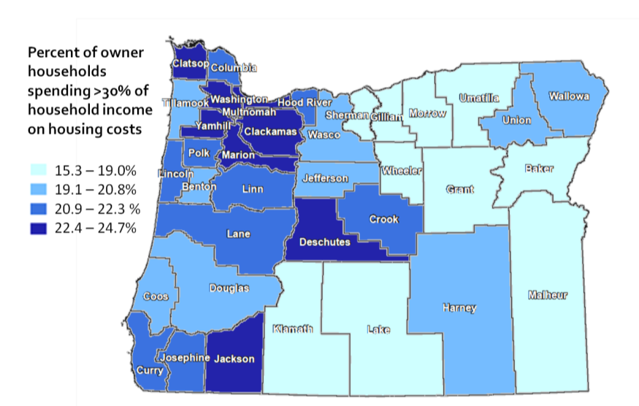
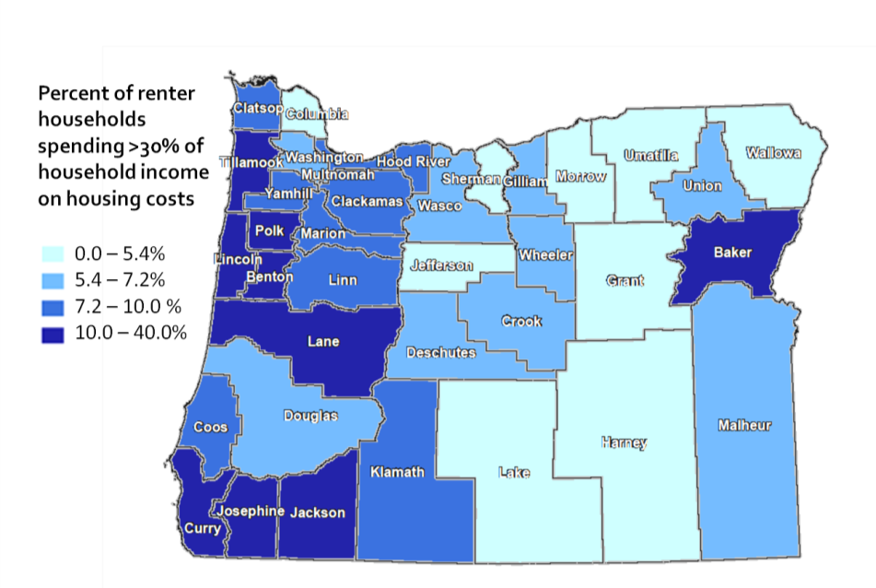
Owner households
Renter households

Slide 24
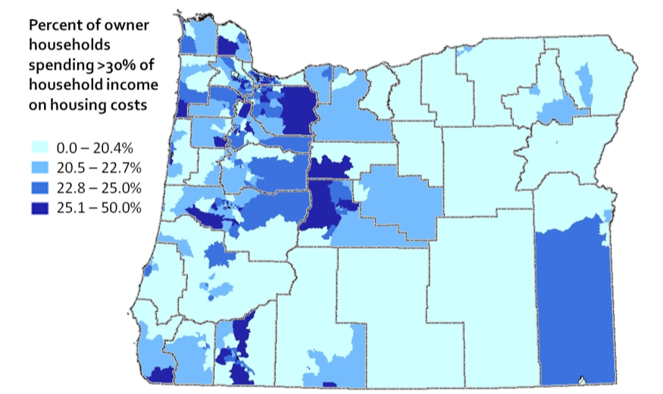
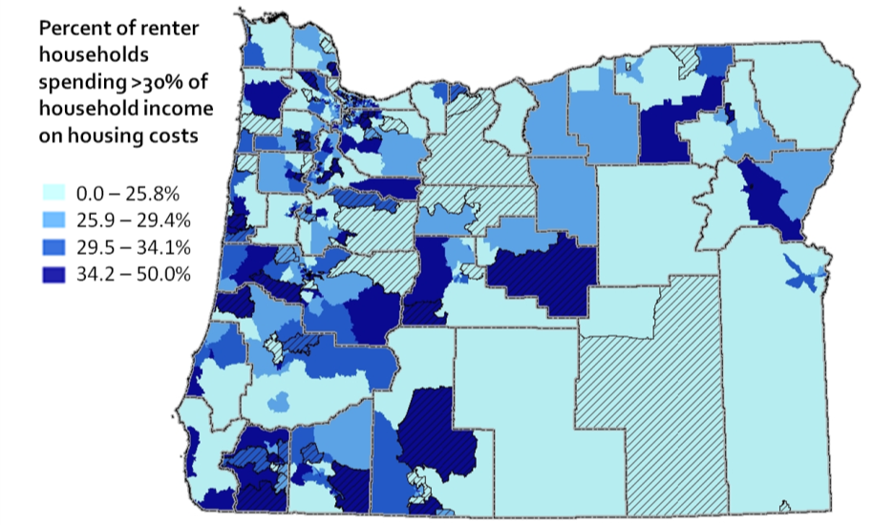
Owner households
Renter households

Slide 25
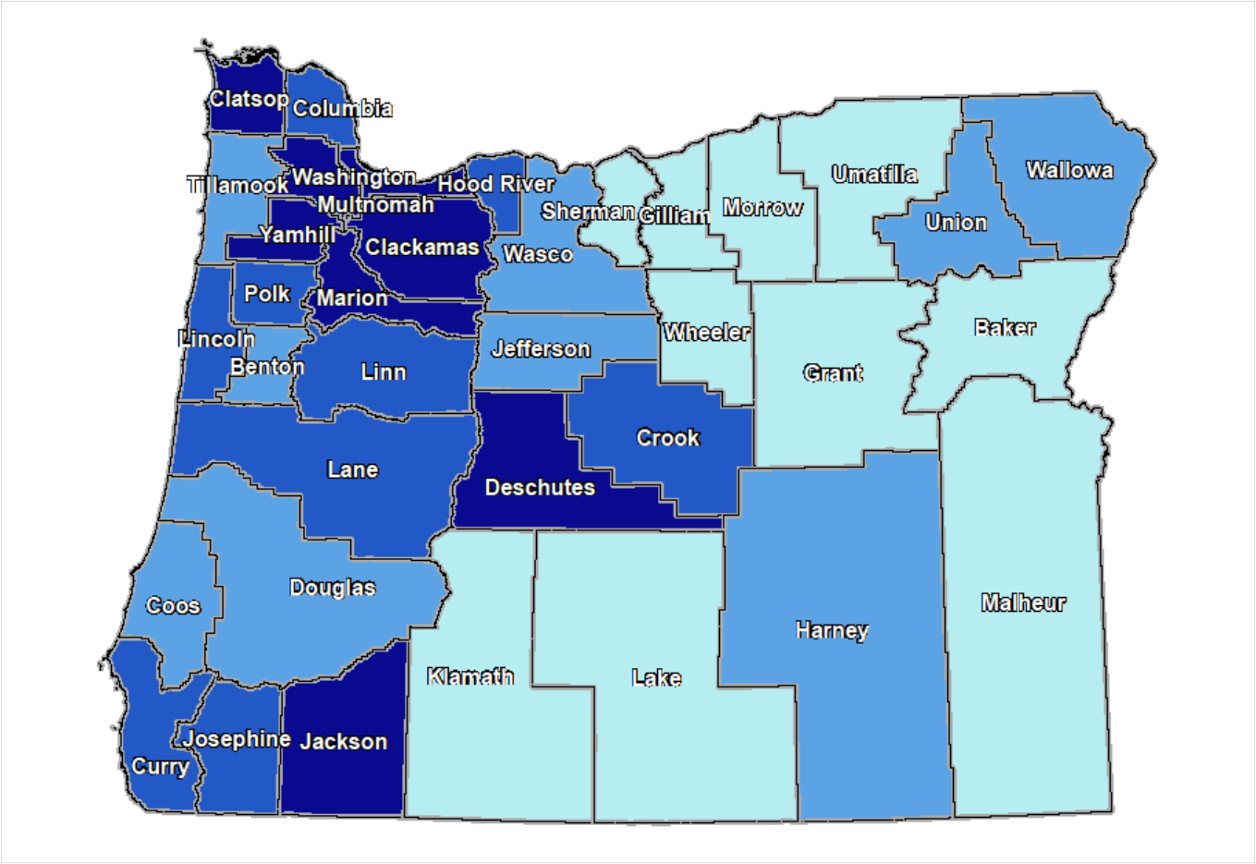
Percent of owner households spending >30% of household income on housing costs
15.3 – 19.0%
19.1 – 20.8%
20.9 – 22.3 %
22.4 – 24.7%

Slide 26
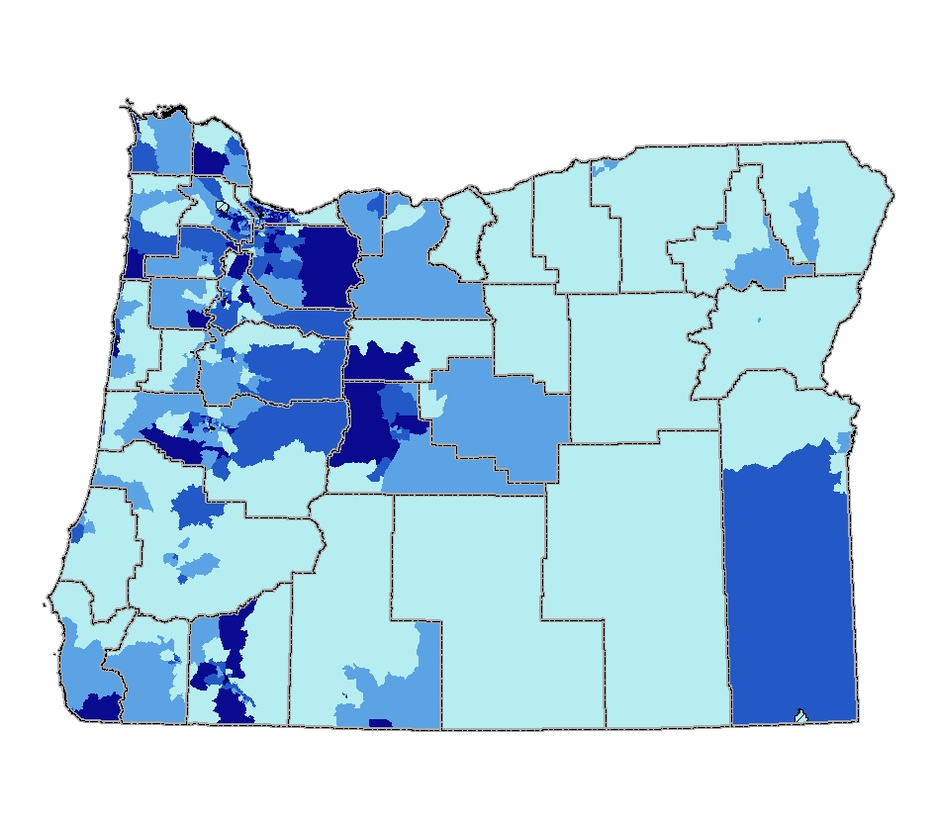
Percent of owner households spending >30% of household income on housing costs
0.0 – 20.4%
20.5 – 22.7%
22.8 – 25.0%
25.1 – 50.0%

Slide 27
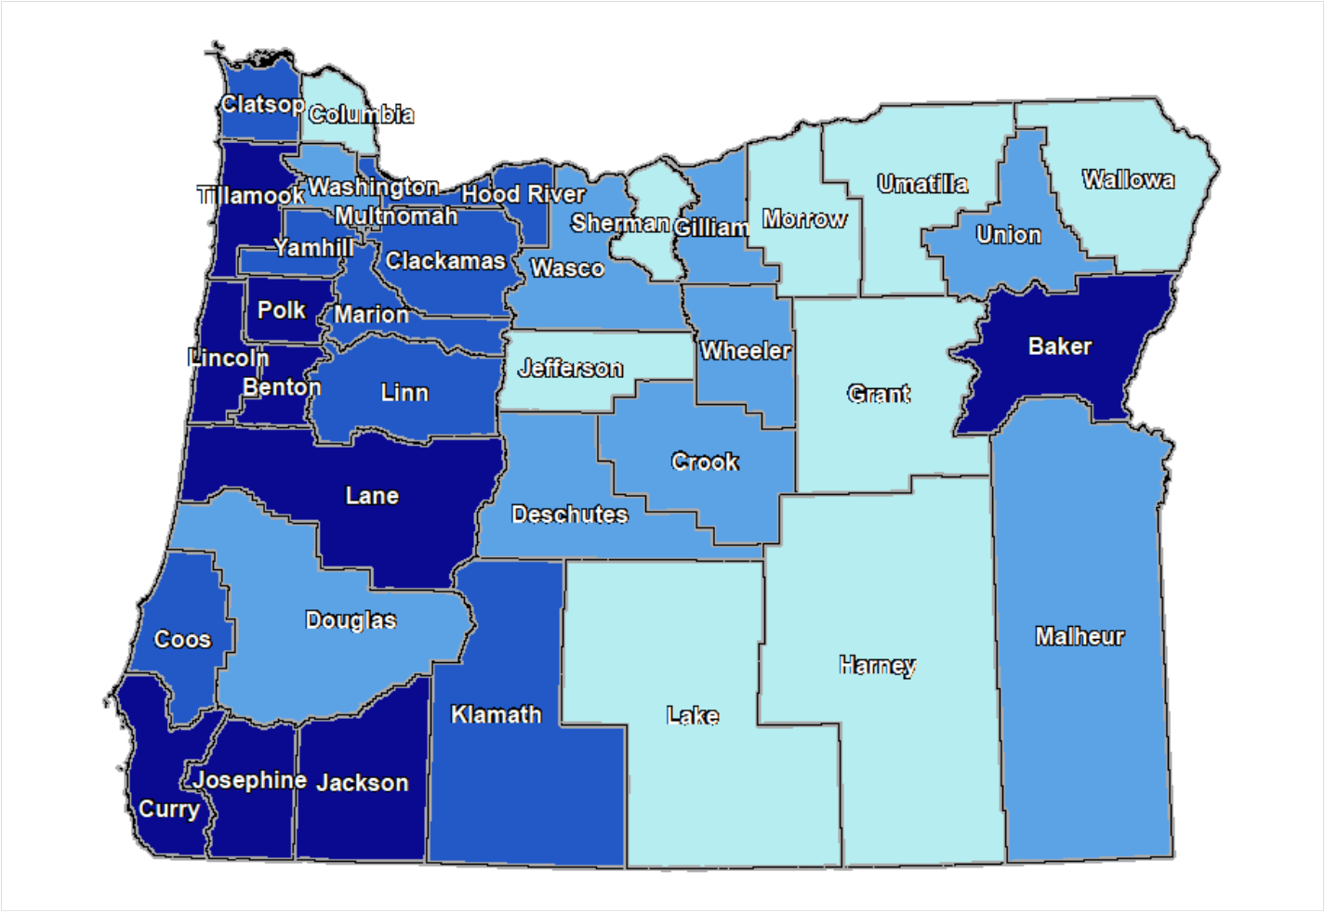
Percent of renter households spending >30% of household income on housing costs
0.0 – 5.4%
5.4 – 7.2%
7.2 – 10.0 %
10.0 – 40.0%

Slide 28
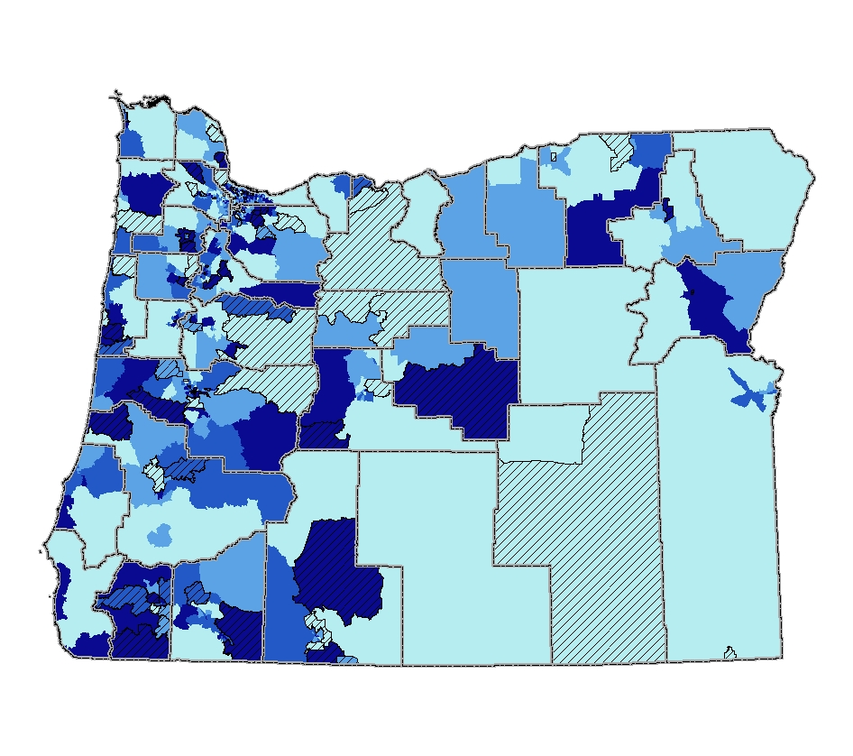
Percent of renter households spending >30% of household income on housing costs
0.0 – 25.8%
25.9 – 29.4%
29.5 – 34.1%
34.2 – 50.0%

Slide 29
Up Next: Recreation Facilities
Measure | Description | Data Sources | Display | Definitions
Access to parks and greenways | % of population residing within X miles of a designated park or greenway | Oregon Parks Dept, GEO, Local GIS office parks and open space inventories | choropleth + locations of facilities | Parks: are defined by local jurisdictions and may include state, county, city and regional parks
Access to public schools | % of population residing within X miles of public school grounds | Oregon GEO school locations |  | Public schools: are enumerated by the Dept of Education
Access to parks, greenways and public schools | % of population residing within X miles of a designated park, trail or public school grounds | Oregon Parks Dept, Local GIS office parks and open space inventories |  | See above definitions.
Bikeway density | Ratio of miles of existing bikeways to square miles | Local GIS office bike routes |  | Bikeways: Defined by local MPO. Must be existing, marked bike lanes, off-street paths, or bike boulevards
Access to indoor recreation facilities | % of population residing within X miles of an indoor facility | Dept of Employment |  | Indoor facilities: gyms, swimming pools, athletic clubs

Slide 30
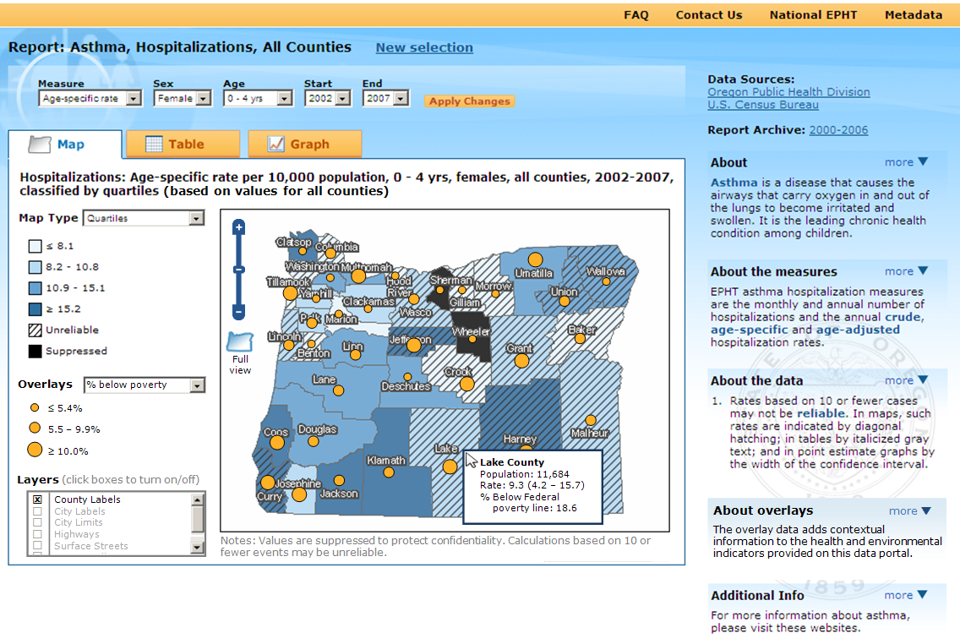
Demographic Overlays
Notes:
This is a screen shot of our data portal with a mock-up of how demographic data might be overlaid on top of other indicators.
Will include:
Race/ethnicity
Income
Education
Age

Slide 31
Questions or Comments?
Contact Info:
Dan Rubado, Epidemiologist
Oregon Environmental Public Health Tracking Program
Phone: 971-673-1210
E-mail: daniel.j.rubado@state.or.us

